Slide 2
The trap depth-> stability of ion
The trap height-> noise interference
The heating heat -> the de-coherence time
（Johnson noise, electrodes surface pieces of the potential）
Care about 1. power lost in substrate, and 2. voltage lost
Every electrodes -> contribute to the potential above surface

Slide 3
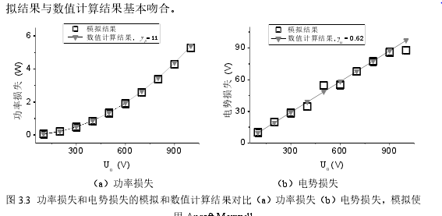
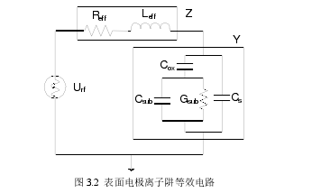


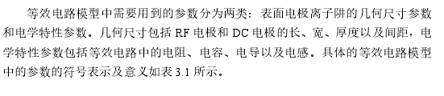
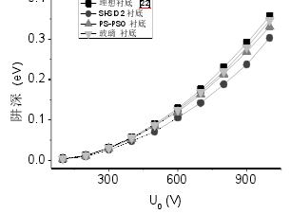

国防科大: 电势 功率在电极上的loss

Slide 4
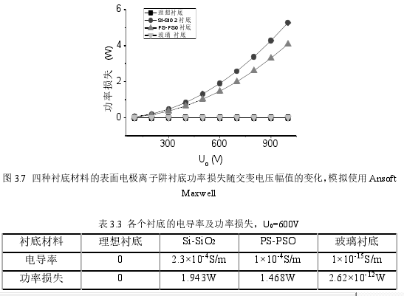
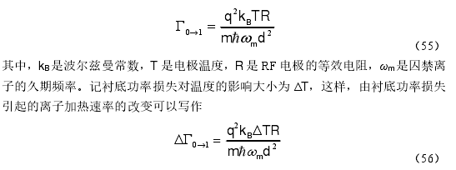

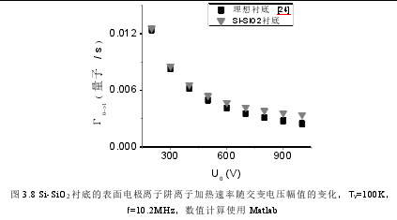
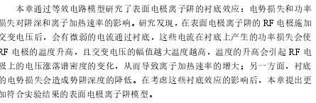
国科大 Heating rate
对外散热的热力学分析

Slide 5
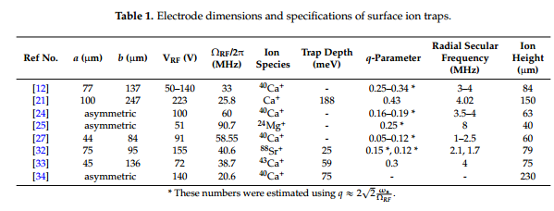
Guidelines for Designing Surface Ion Traps Using the Boundary Element Method
ISRC/ASRI, Department of Electrical and Computer Engineering, Seoul National University
All care about RF

Slide 6
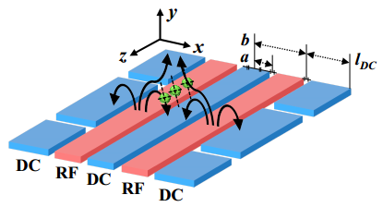
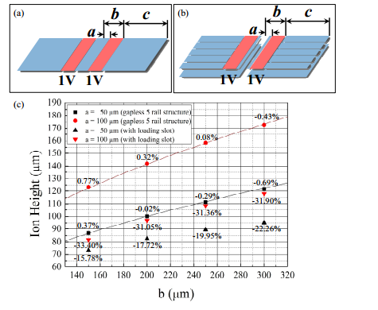

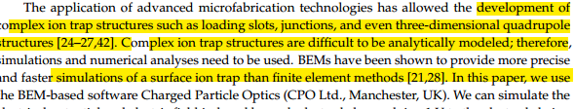

Slide 7
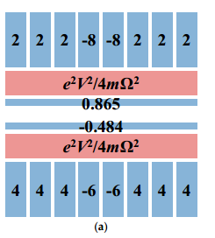
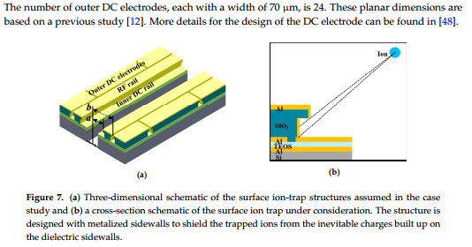
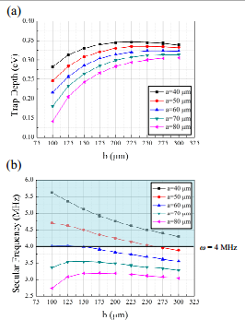
The design of DC

Slide 8
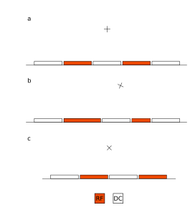
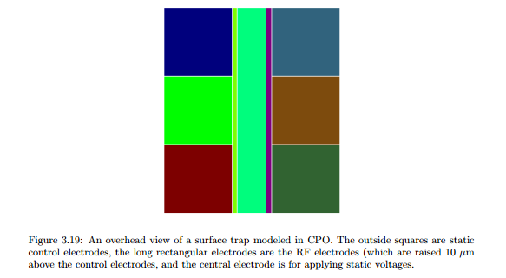
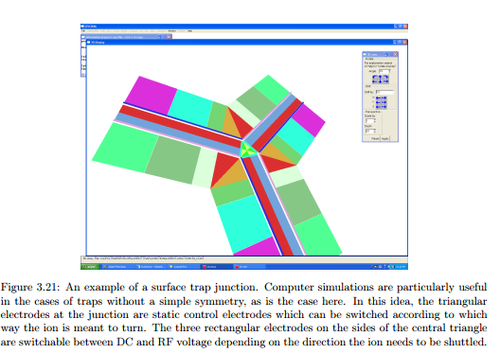
Fabrication and characterization of semiconductor ion traps for quantum information processing
The University of Michigan software ：CPO

Slide 9
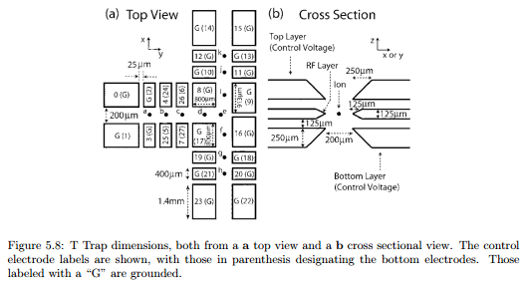
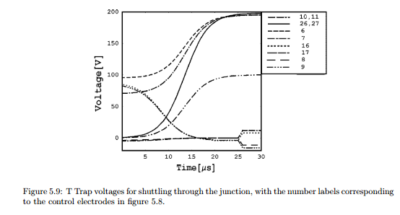
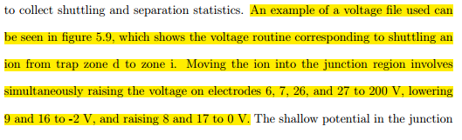

Slide 10
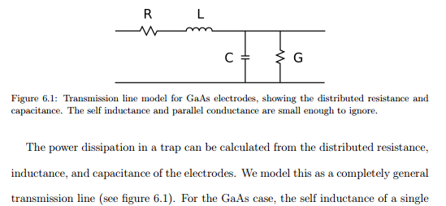
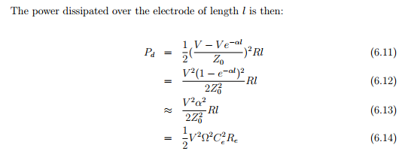

Slide 11
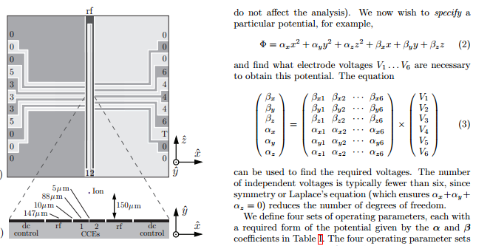
Implementation of a symmetric surface electrode ion trap with field compensation using a modulated Raman effect

Slide 12
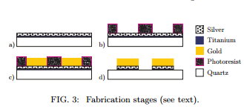

Slide 13
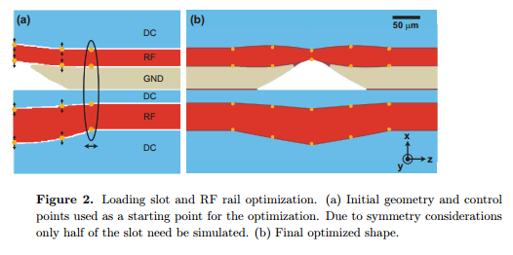

Controlling fields in a microfabricated ion trap through design and compensation
Georgia Tech Research Institute, Atlanta, Georgia, 30332
To address these issues it is desirable to minimize local pseudopotential deformations and maintain a constant ion height over the loading zone

Slide 14
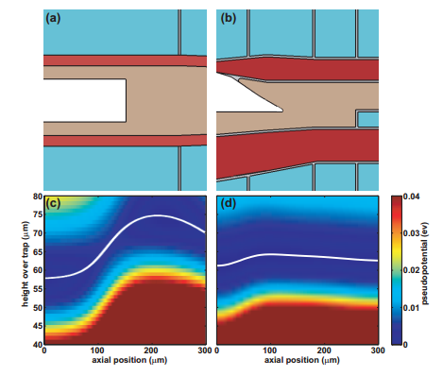
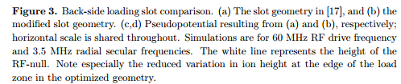


Slide 15

Design, fabrication and experimental demonstration of junction surface ion traps
Sandia National Laboratories, Albuquerque, NM 87185, USA

Slide 16
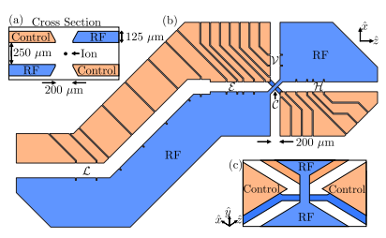
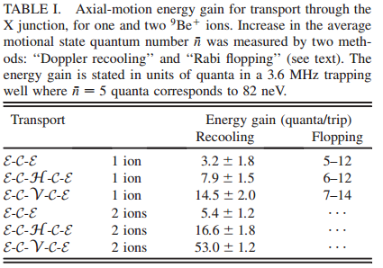
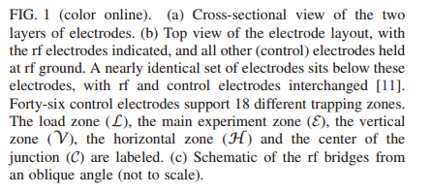
High-Fidelity Transport of Trapped-Ion Qubits through an X-Junction Trap Array
National Institute of Standards and Technology, 325 Br

Slide 17
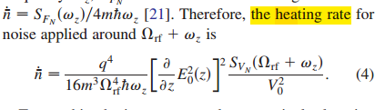
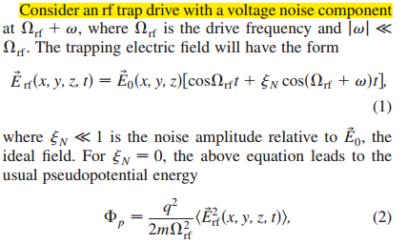
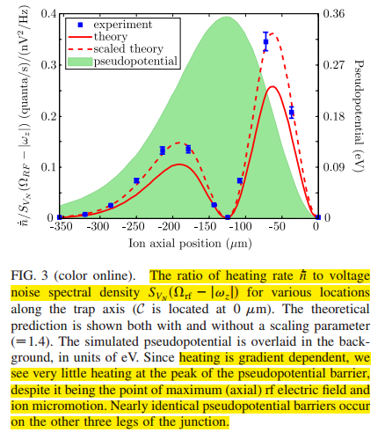
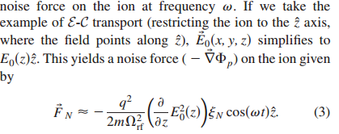
Voltage noise
The trap center
Is where
Lowest heating rate

Slide 18
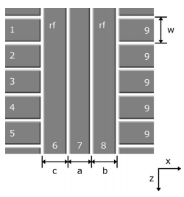
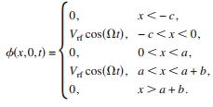
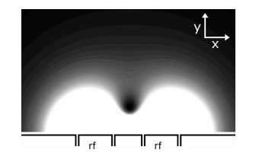

Analytic model for electrostatic fields in surface-electrode ion traps
Department of Physics and Astronomy, University of California–Los Angeles, Los Angeles RF

Slide 19
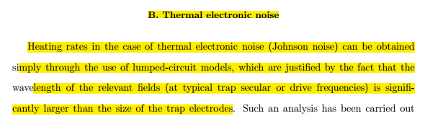
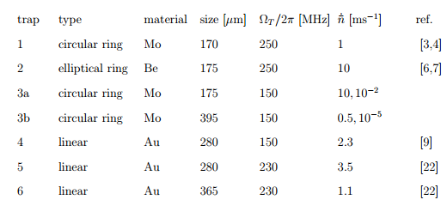

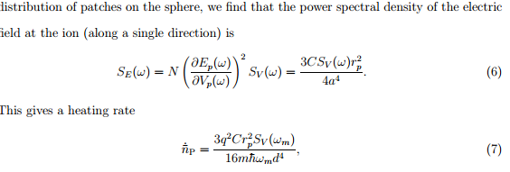
Heating of trapped ions from the quantum ground state
National Institute of Standards and Technology,

Slide 20
Electric feld noise above surfaces: a model for heating rate scaling law in ion traps
Universit´e Paris Diderot et CNRS, UMR 7162

